Slide 1






Open Dota Mobile Client
Group 8

Slide 2




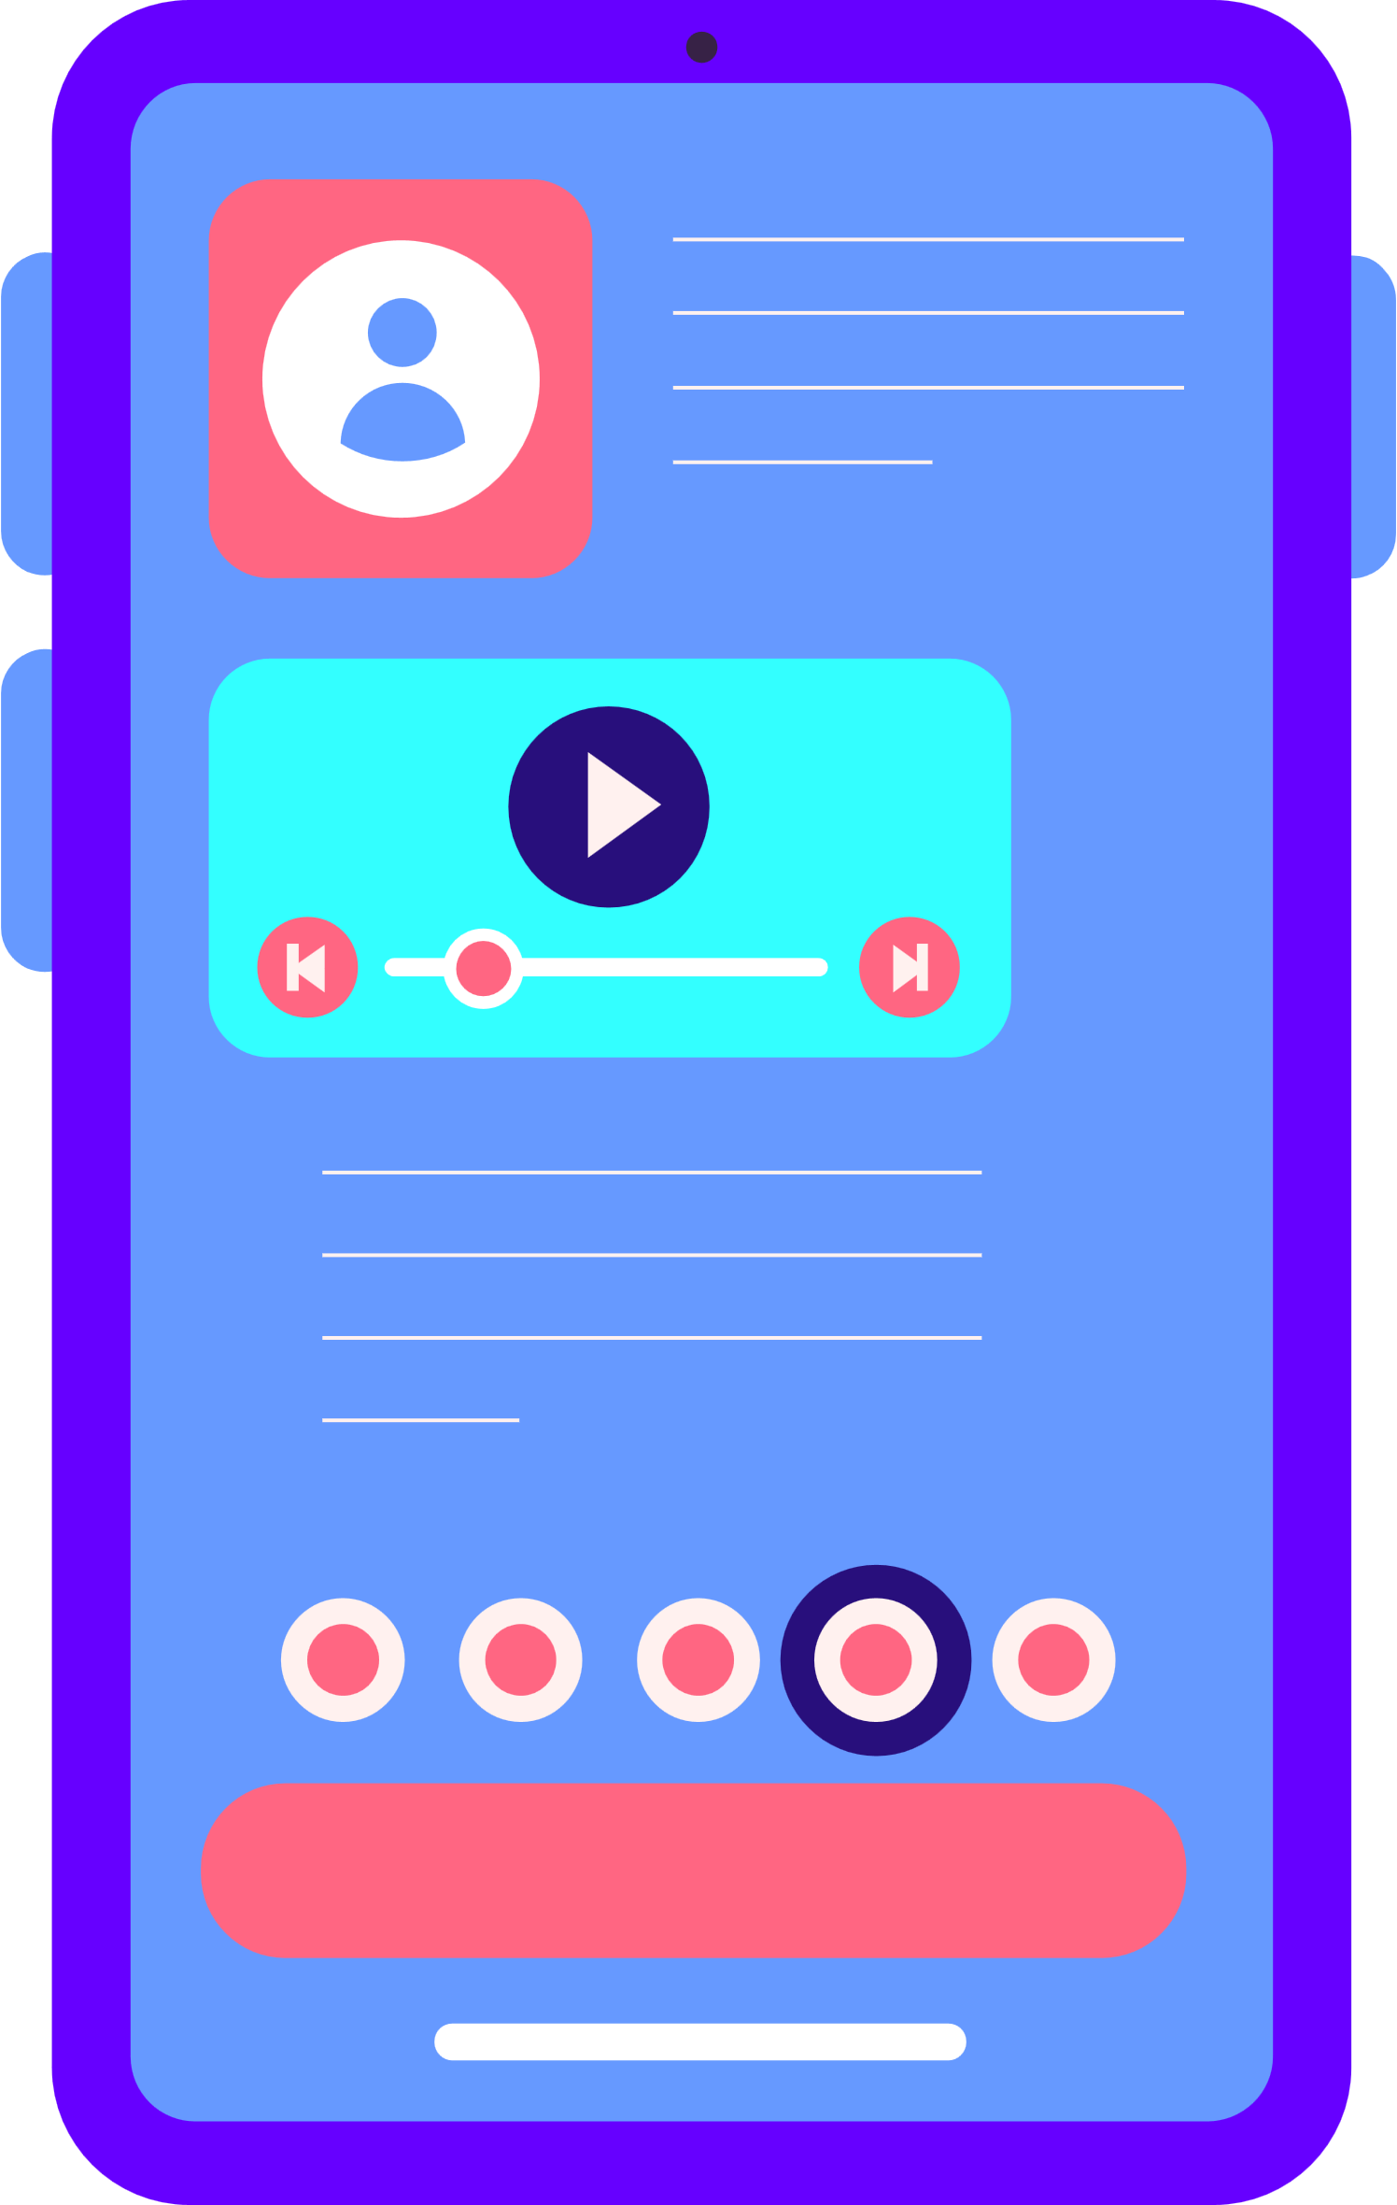



Members
Nguyễn Hoàng Minh
Lê Hoài Nam
Nguyễn Duy Nghĩa
Lê Quang Minh
Nguyễn Viết Minh Đức

Slide 3


Table of contents
01
Introduction
03
Activities
Optimization
05
Function and purpose
Roles and Duties overview
UI overdraw status
02
Architecture
04
06
Demo
Networking
Main Components and figures
Functionally
API Access

Slide 4



01
Introduction

Slide 5




Function:
Provides mobile access to Dota 2 stats and match history.
Tracks performance metrics like win rates, hero stats, and match analysis.
Includes hero builds
Enables users to review past games and track improvement

Slide 6


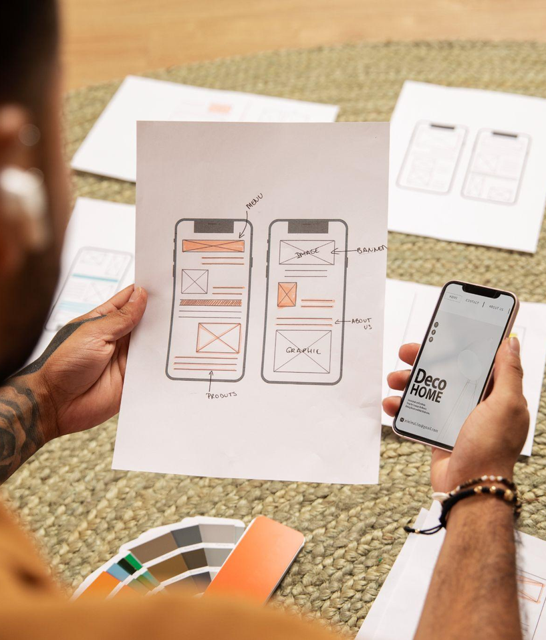
Purpose:
Convenient access to stats and performance on the go.
Instant updates on match results and leaderboards..
Keeps players informed on competitive matches and the pro scene.

Slide 7






02
Architecture
Main Components and figures

Slide 8


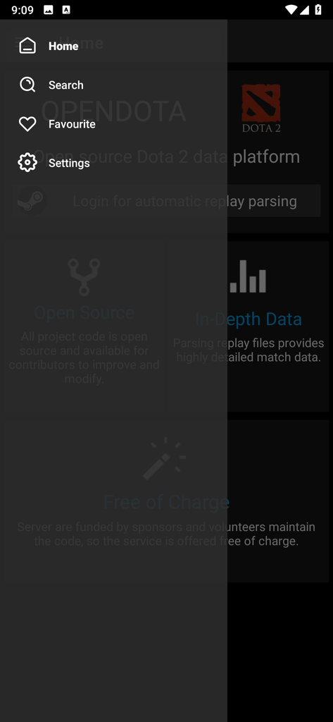

Main
Home
Search
App introduce
Searching players' name and match history
Favourite
Setting
Following and tracking another players
Changing theme's color

Slide 9
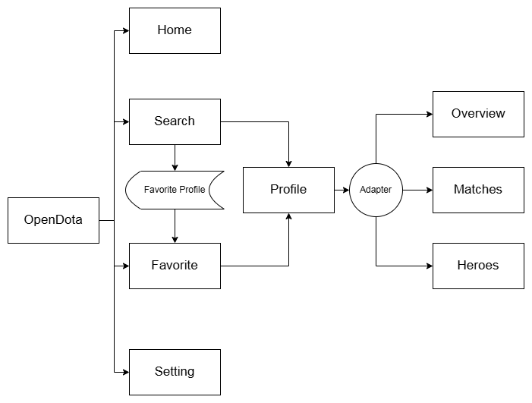
Figures

Slide 10


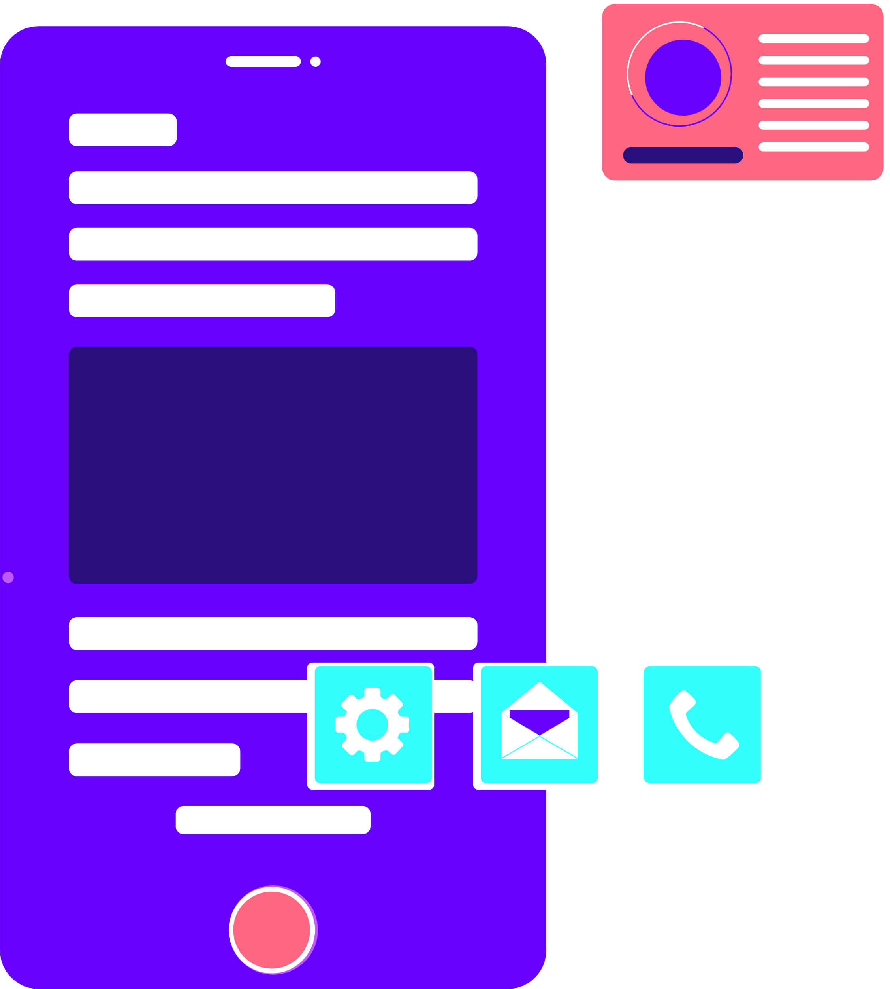


03
Activities
Roles and Duties overview

Slide 11





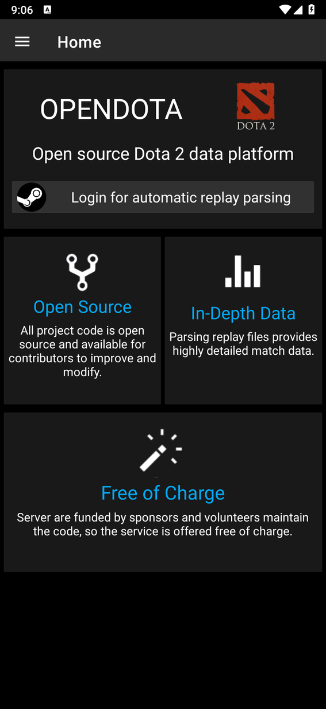
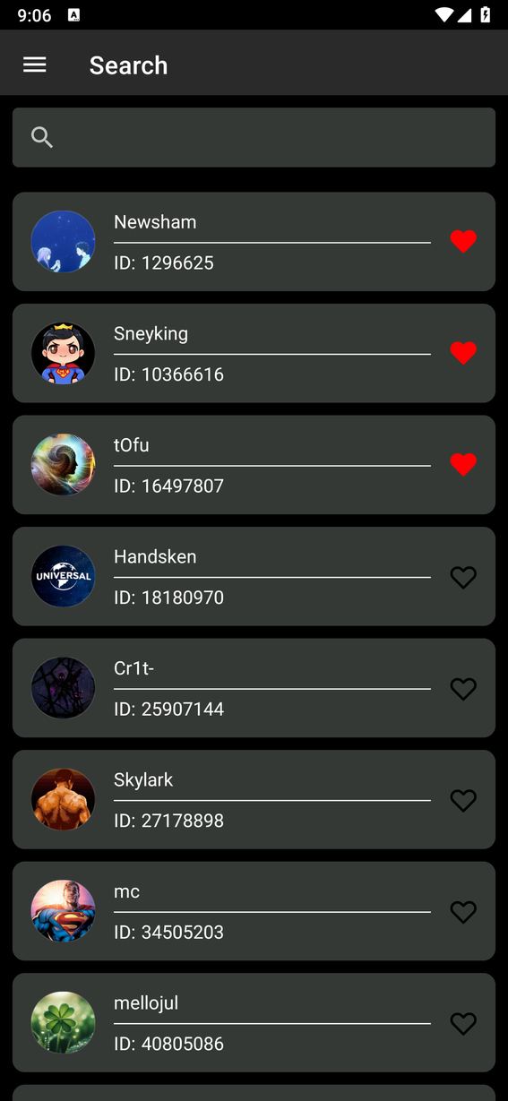

Menu
Home
Search

Slide 12
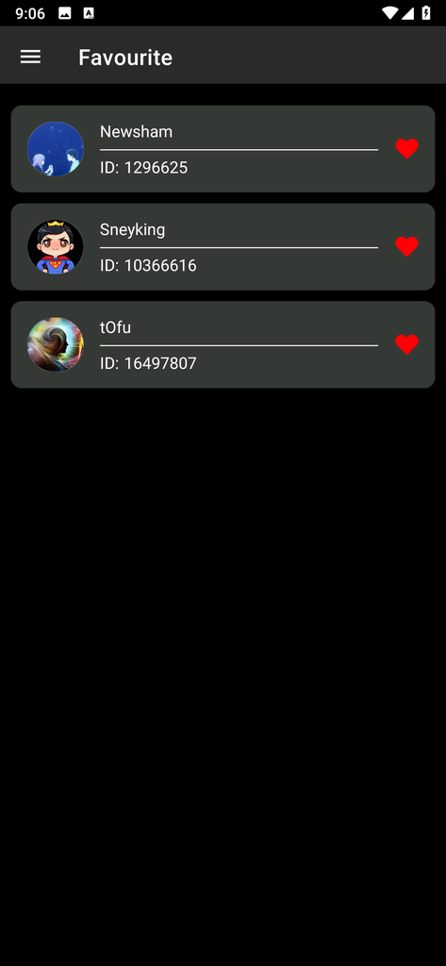
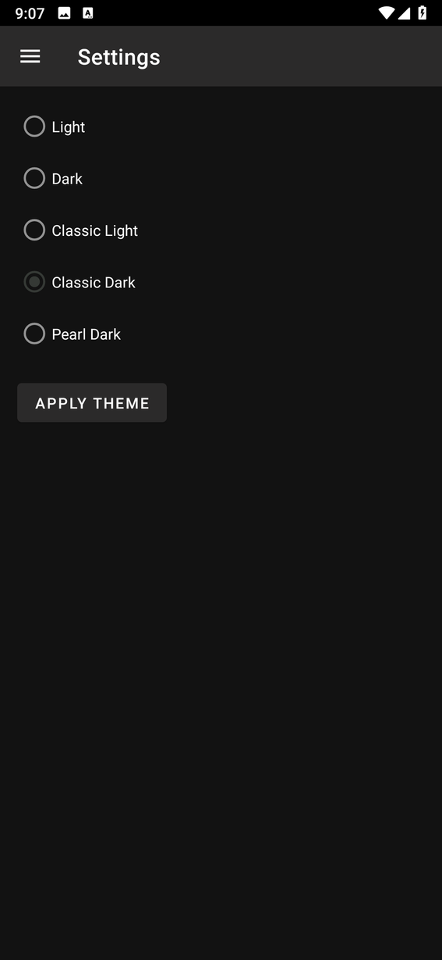
Favourite
Setting

Slide 13



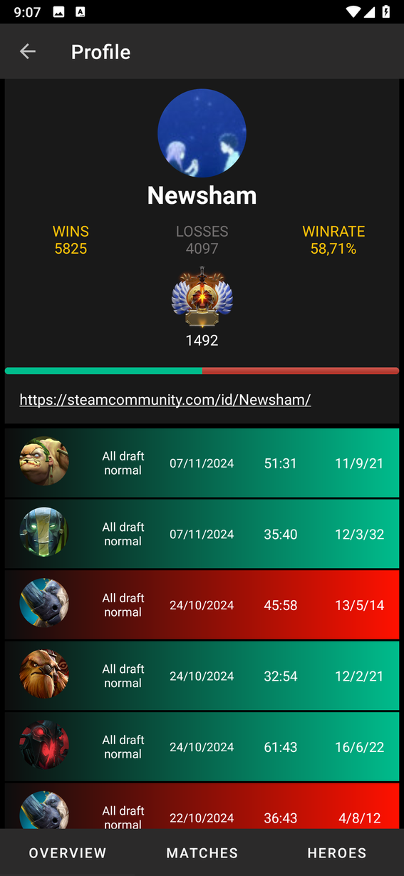
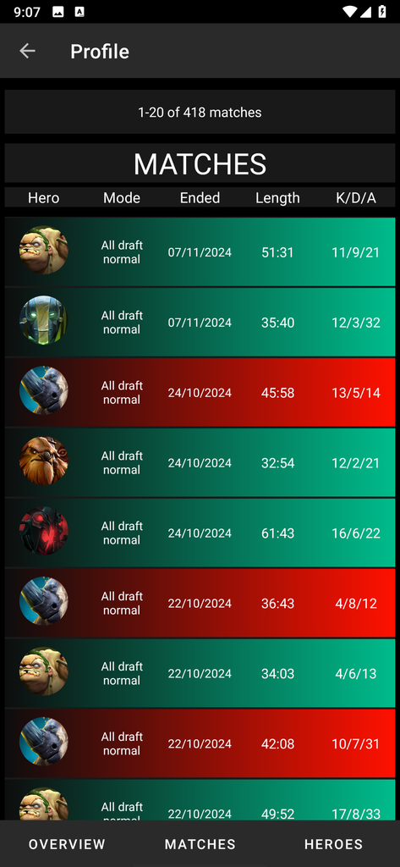
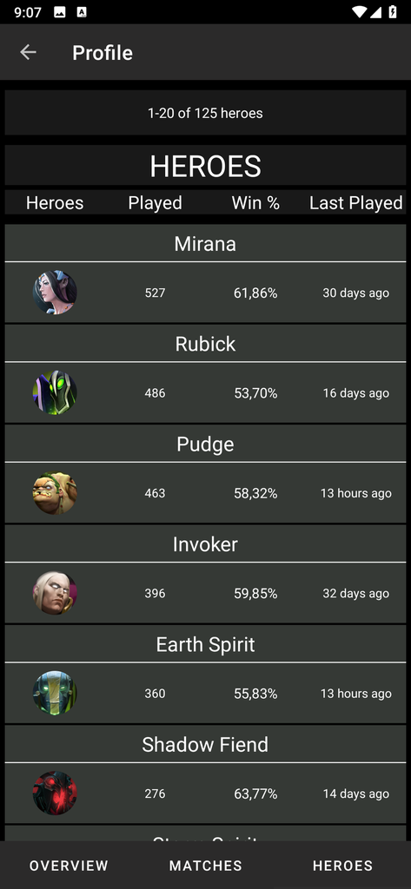

My profile

Slide 14



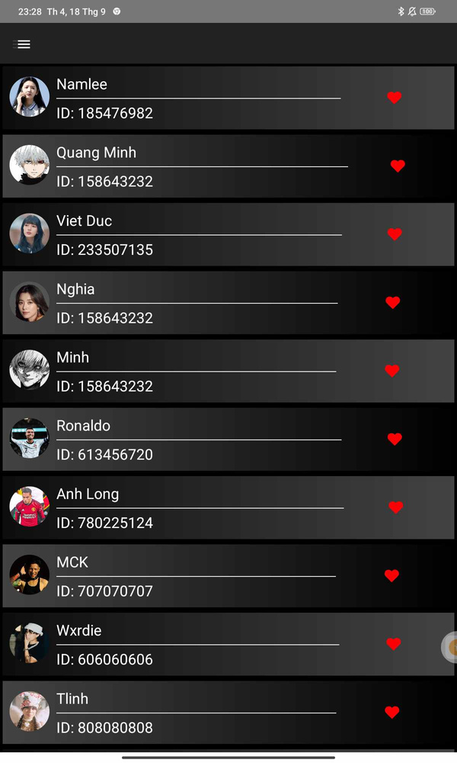
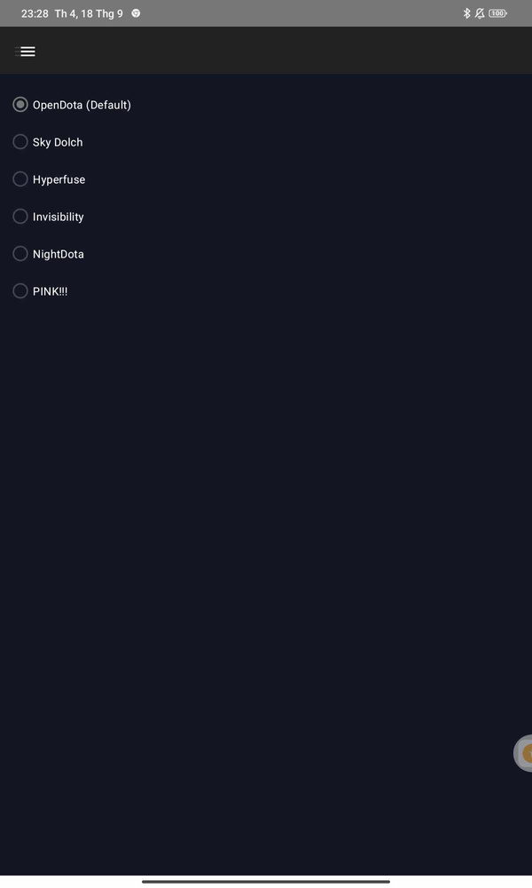

Favourite
Setting
04
Networking
API Access

Slide 15

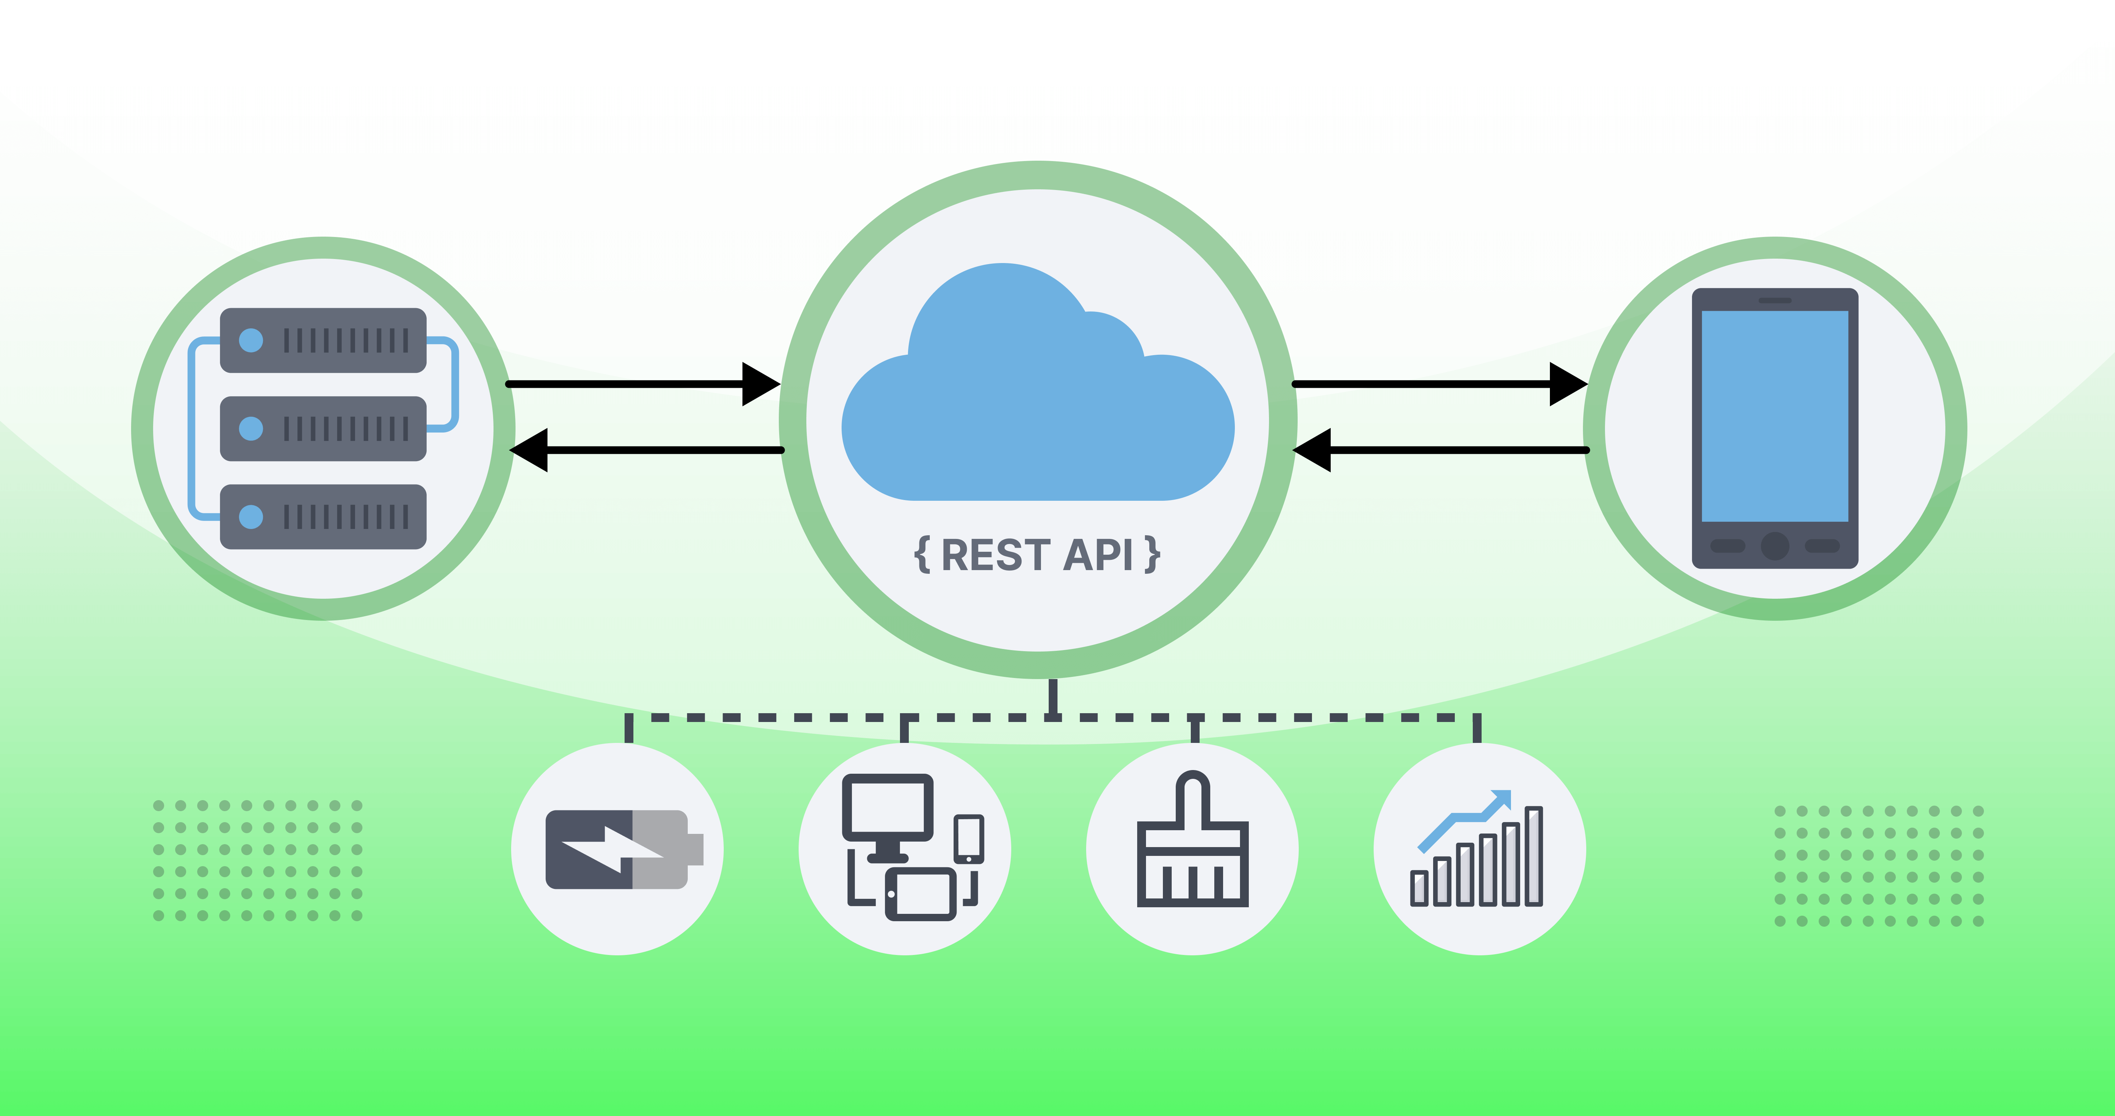
API Acess
- Connect to dotaconstants repository
- To find data that can be used to convert hero an ability IDs and other information provided by the API
- Async acess
- REST API

Slide 16
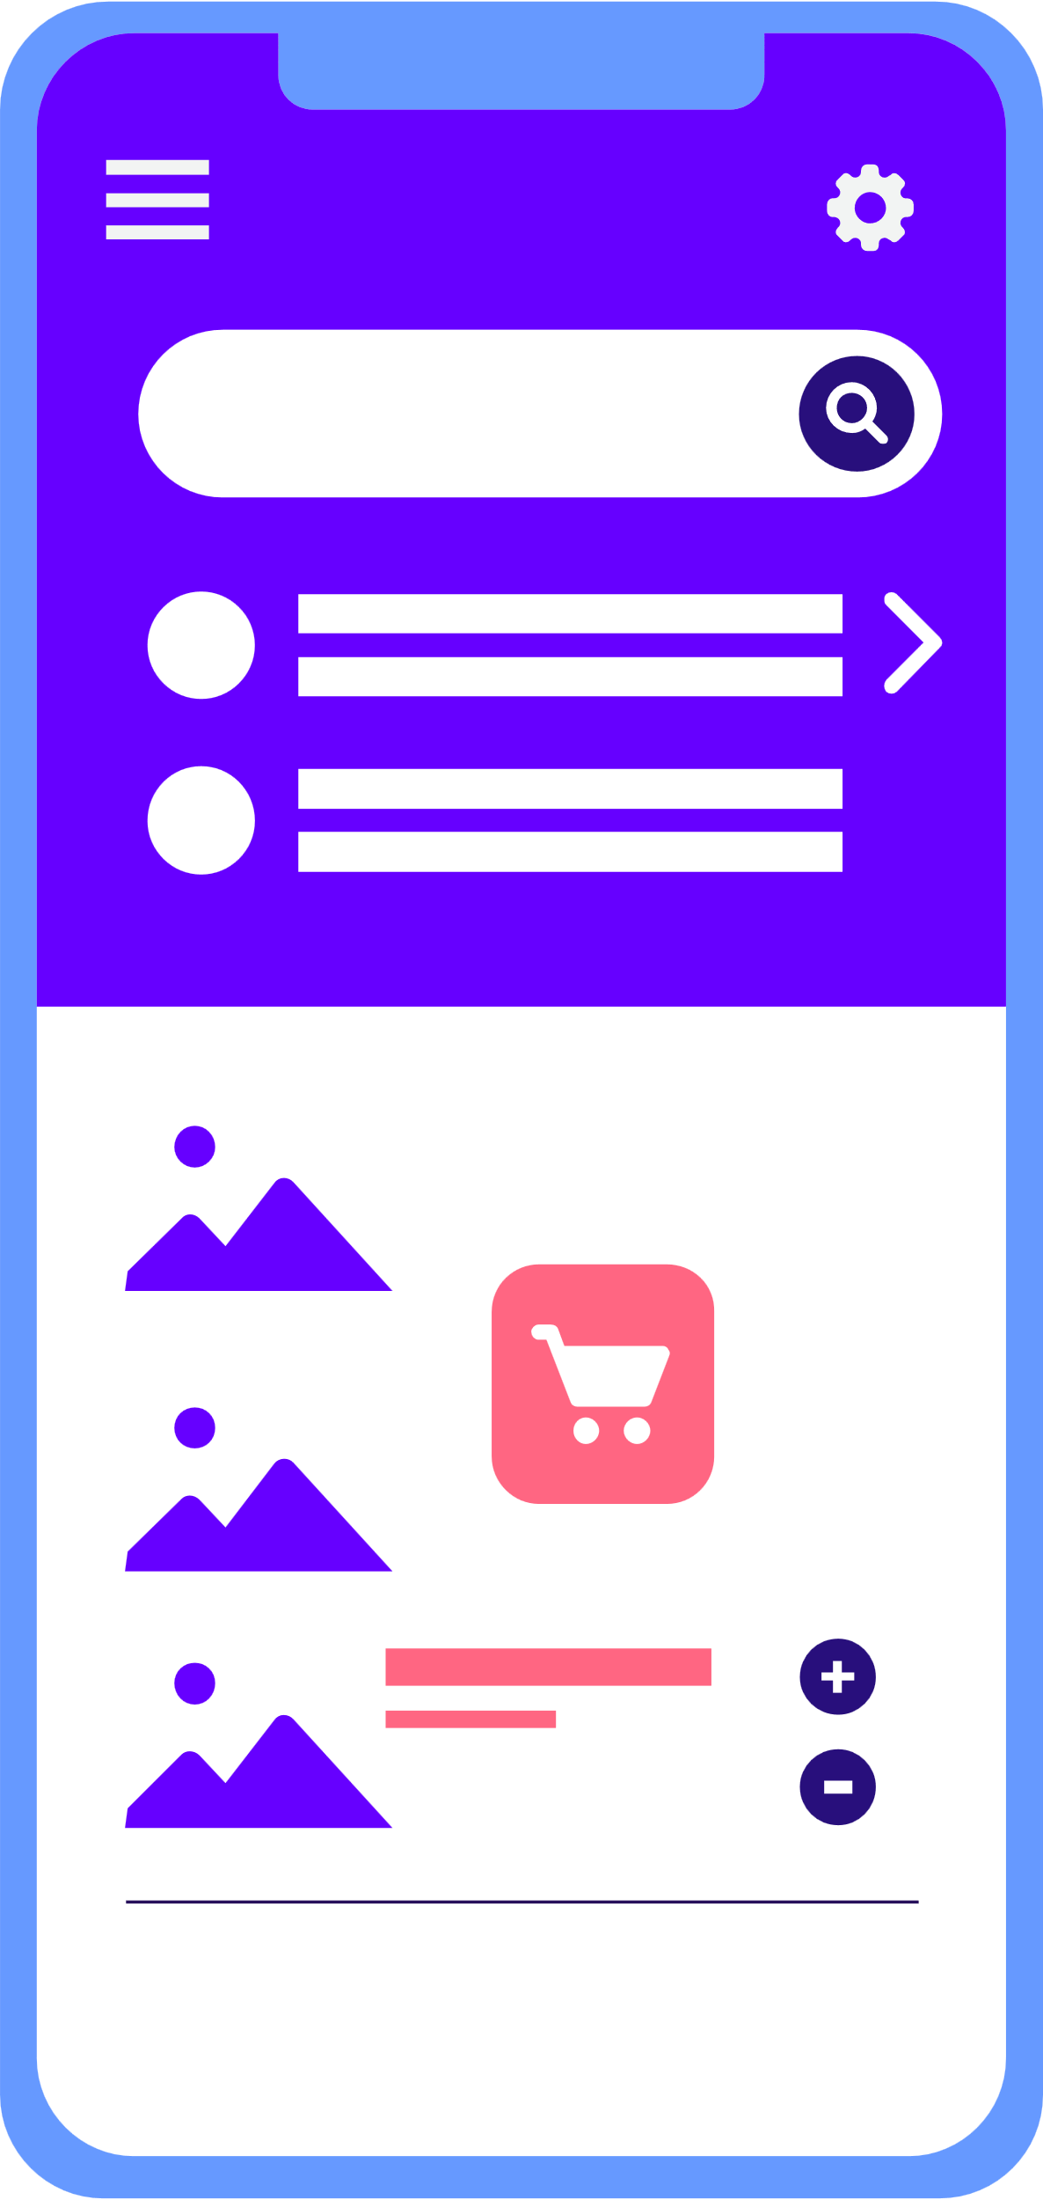
05
Optimization
UI Overall Status

Slide 17
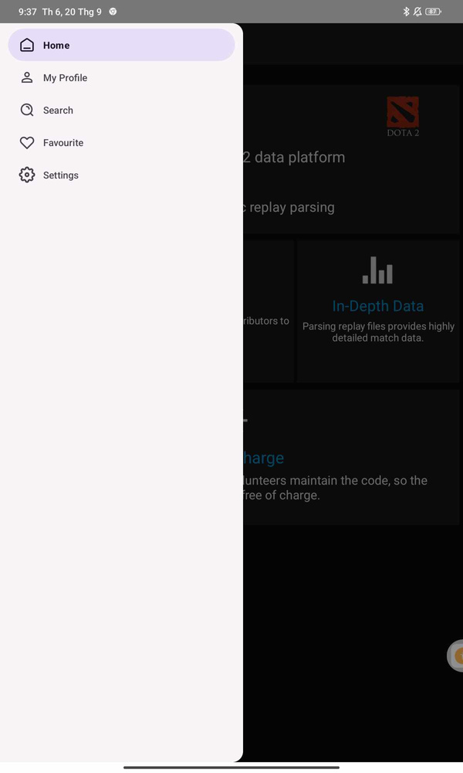
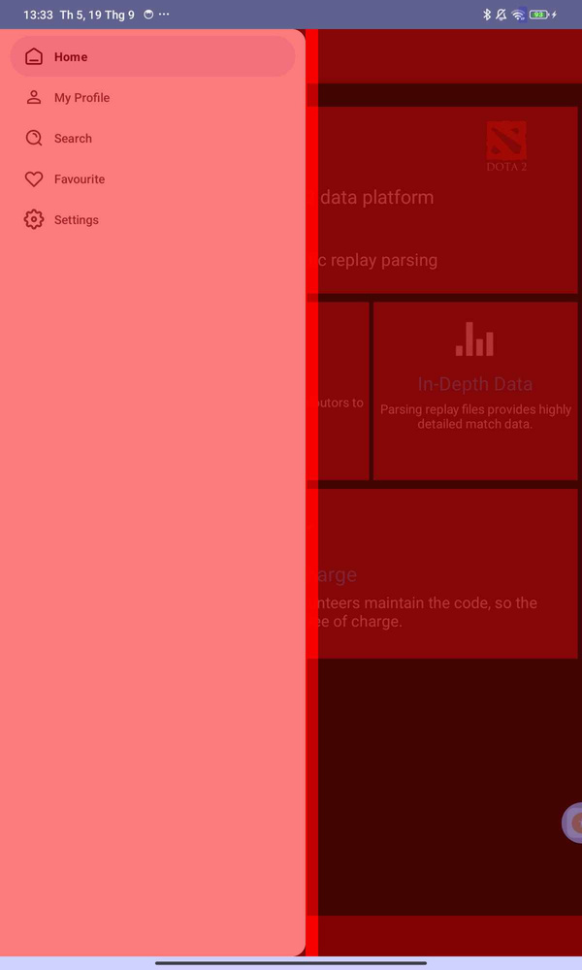
UI overdraw status

Slide 18
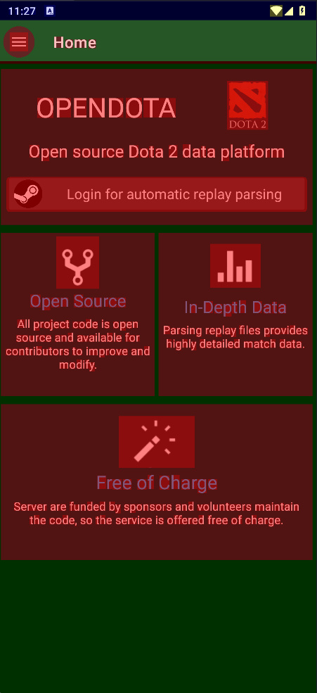
UI overdraw status

Slide 19
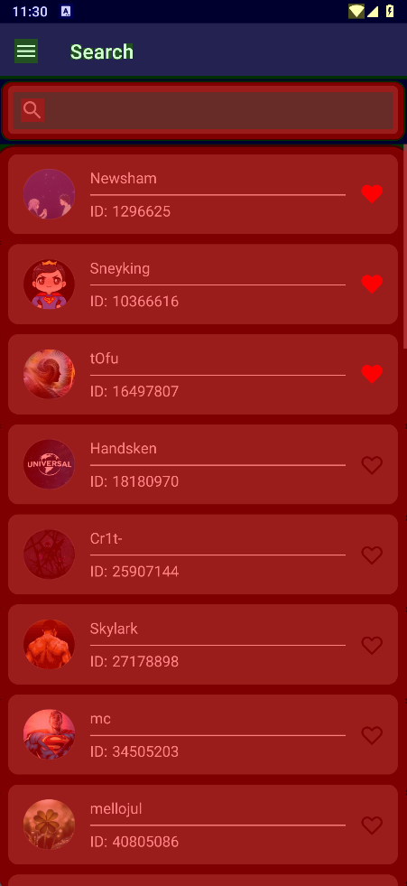
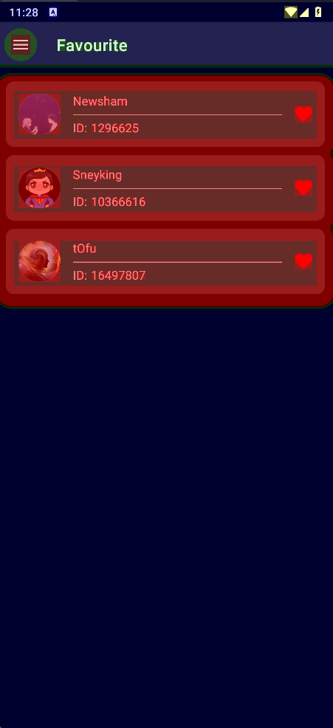
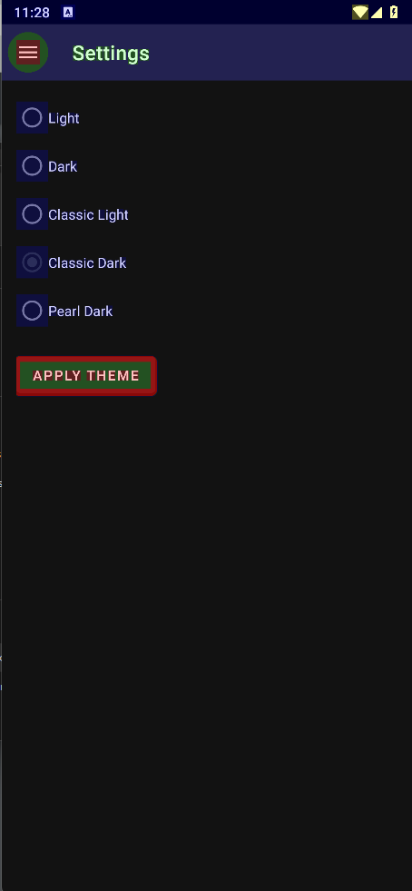
UI overdraw status

Slide 20
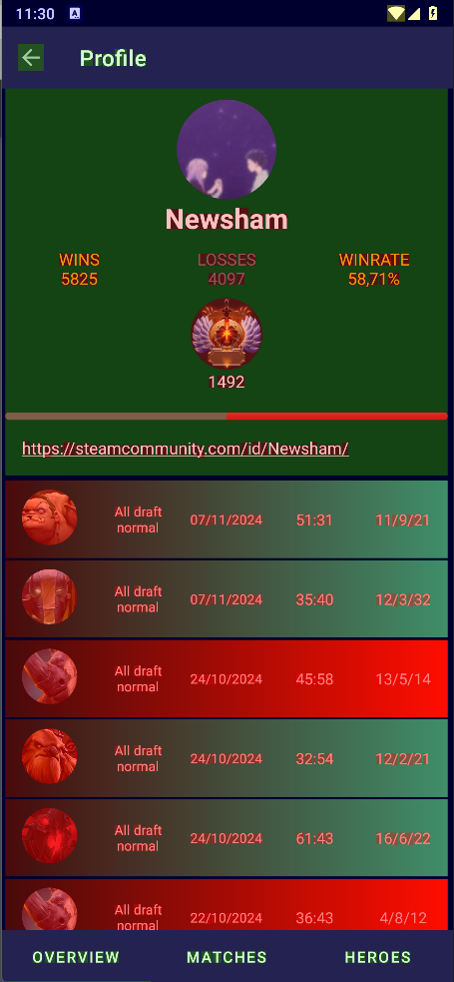
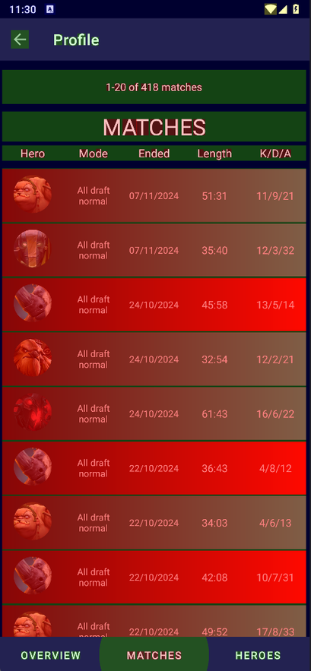
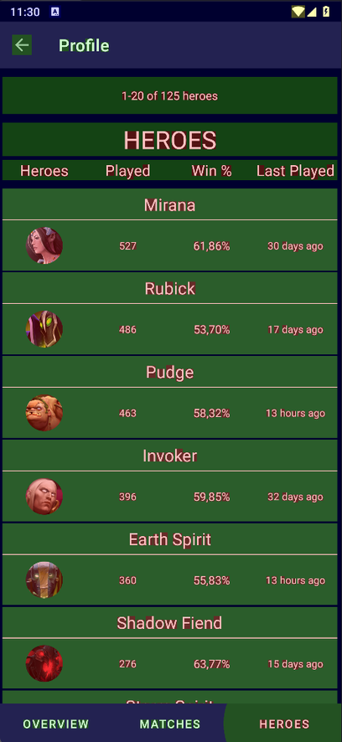
UI overdraw status

Slide 21






06
Conclusion
Get all necessary information about profile, match, hero.
Linking profile from search to favorite
Changing theme colors
Future:
Create login for user
Changing Home to User’s profile after login
Show matches details

Slide 22
07
Demo running app

Slide 23

Thank you for listening !

